Slide 1
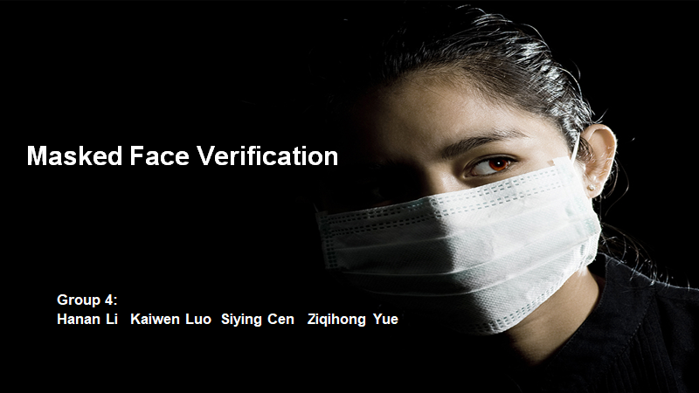
Video link:
https://drive.google.com/file/d/1P0kYvnNSjQoRKWY6j8fCA_6VTLRcHDOS/view

Slide 2
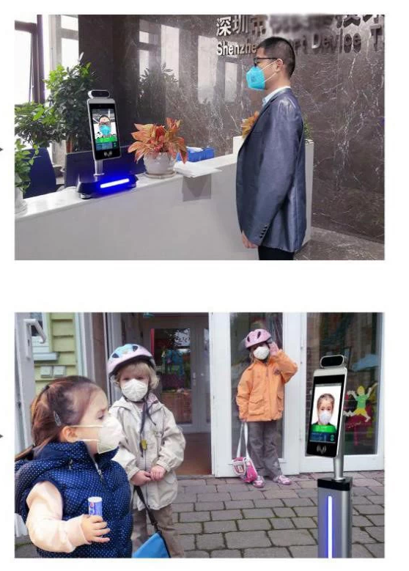
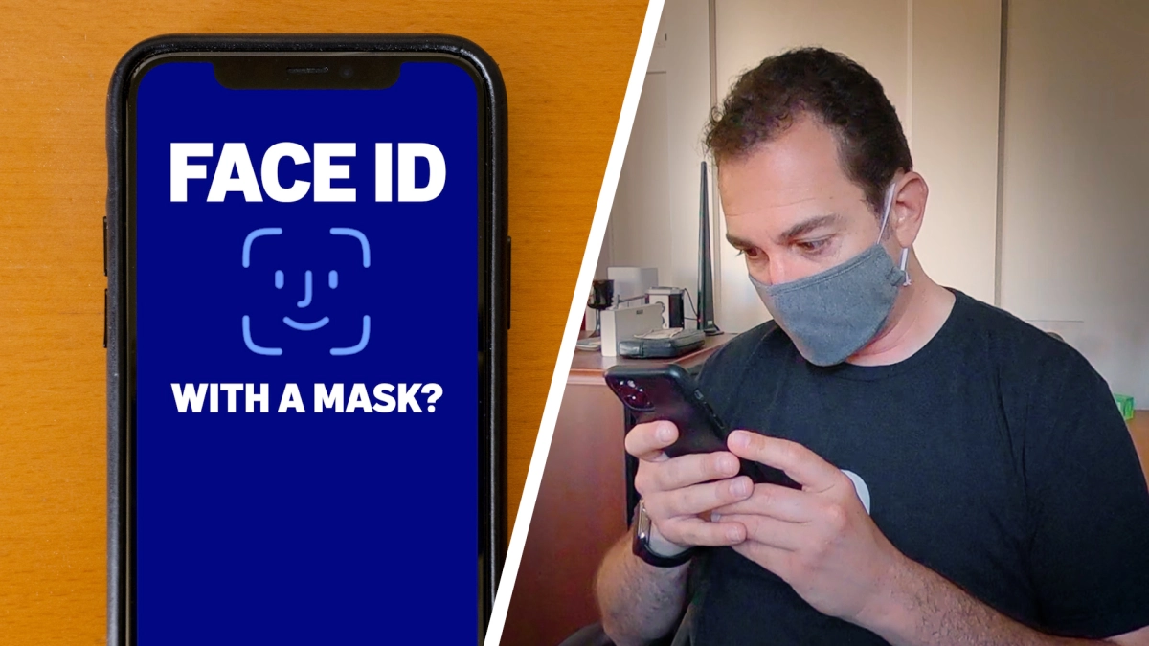
Motivation
Motivation
Ziqihong Yue
Face ID unlock problem
Face Recognition with mask

Slide 3
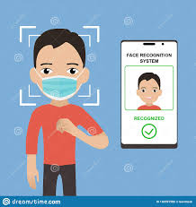
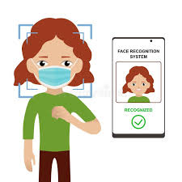
Our Goals:
Ziqihong Yue
Develop a deep learning model that can perform facial verification with masks.
This model should be able to have the high security level as the general facial verification model.
Develop a website as a platform to show how our model works

Slide 4
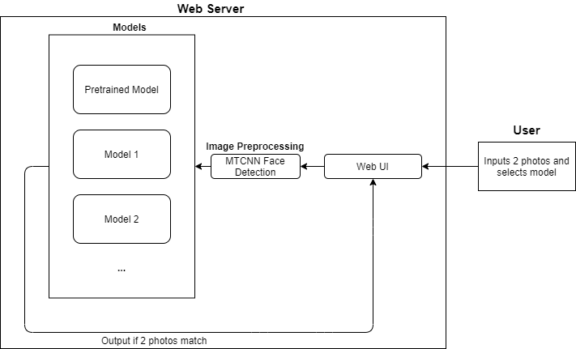
System Architecture
Siying
Notes:
First detect face? And then use NN models to extract embeddings ?
Not sure the relation between Resnet, Facenet, mtcnn. How do we combine those together.
Facenet based on Resnet.
Kevin
Change Architecture drawing a bit to include web ui

Slide 5
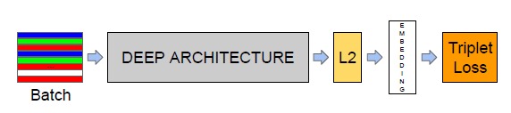
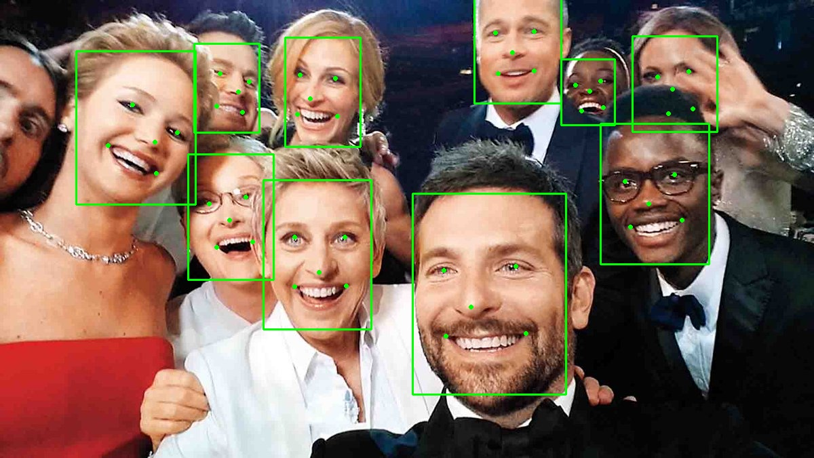
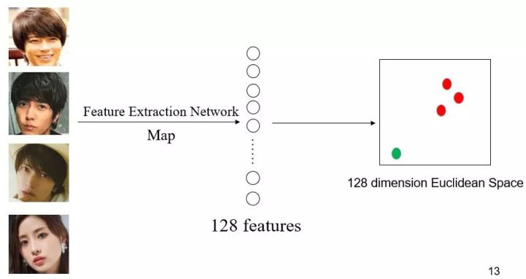
MTCNN: Face Detection
FaceNet Embeddings
Siying
FaceNet: A Unified Embedding for Face Recognition and Clustering.
https://arsfutura.com/magazine/face-recognition-with-facenet-and-mtcnn/
Notes:
MTCNN or Multi-Task Cascaded Convolutional Neural Networks is a neural network which detects faces and facial landmarks on images.
Facenet uses MTCNN. (b) MTCNN can recognize face with mask
It is one of the most popular and most accurate face detection tools today.
FaceNet is a deep neural network used for extracting features from an image of a person’s face.
Advantage: Pose invariant, emotion invariant, lighting invariant
We can plot an image of a face in the coordinate system using its embeddings. Embeddings are vectors and we can interpret vectors as points in the Cartesian coordinate system.
If the face embedding of a unseen image is close enough to embeddings of person A, we say that this image contains the face of person A.

Slide 6
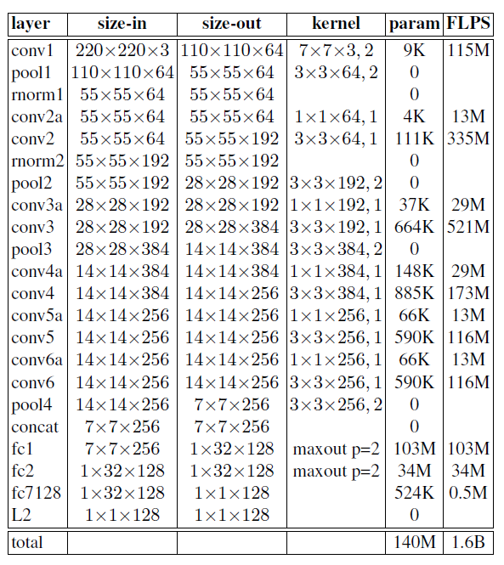
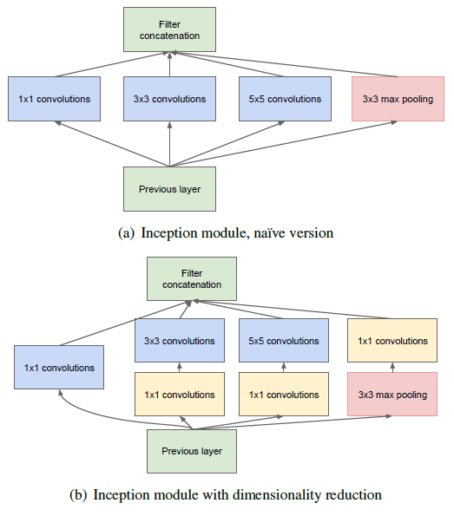
Facenet Deep Architecture
NN1
Zeiler&Fergus based model
NN2
GoogLeNet style Inception model
Siying
https://medium.com/analytics-vidhya/inception-network-and-its-derivatives-e31b14388bf9
FaceNet: A Unified Embedding for Face Recognition and Clustering.
Notes:
In Inception Modules, the input goes through 1×1, 3×3 and 5×5 conv, as well as max pooling simultaneously and concatenated together as output.
Where did we use Resnet.

Slide 7
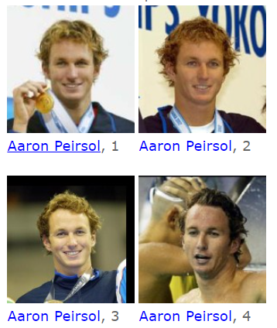
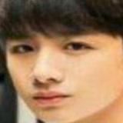
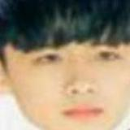
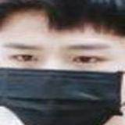
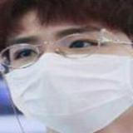
Datasets:
Real World Masked Face Recognition Dataset (RMFRD)
LFW (Labeled Faces in the Wild)
Siying
AFDB_face_dataset
AFDB_masked_face_dataset
https://www.kaggle.com/muhammeddalkran/masked-facerecognition
http://vis-www.cs.umass.edu/lfw/
Notes:
Labeled Faces in the Wild (LFW) is a database of face photographs designed for studying the problem of unconstrained face recognition.
The data set contains more than 25,000 images of faces collected from the web. Each face has been labeled with the name of the person pictured. 1680 of the people pictured have two or more distinct photos in the data set.
Real World Masked Face Recognition Dataset (RMFRD) contains 5,000 masked faces of 525 people and 90,000 normal faces. The normal faces and masked faces were all crawled online. It contains two sub datasets, AFDB_face_dataset and AFDB_masked_face_dataset; in each sub dataset, folders of different people images were labelled with name.
Problem:
Quality is bad; not so much people. All asians.

Slide 8
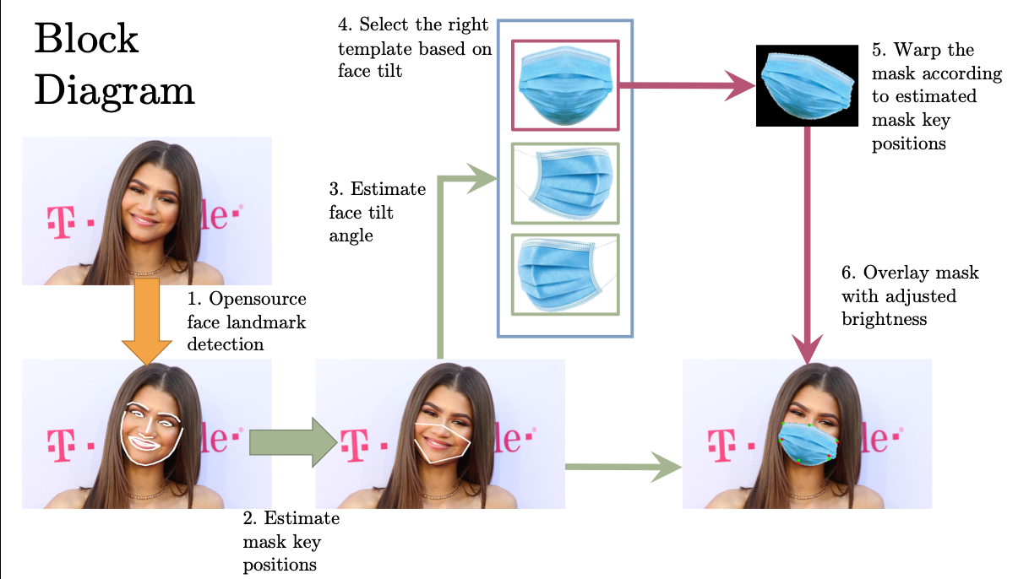
Synthetic dataset:
MaskTheFace
Siying
python mask_the_face.py --path <path-to-file-or-dir> --mask_type random --verbose --write_original_image
https://github.com/aqeelanwar/MaskTheFace
Notes:
3. LFW -> maskedLFW
MaskTheFace is computer vision-based script to mask faces in images. It uses a dlib based face landmarks detector to identify the face tilt and six key features of the face necessary for applying a mask. Based on the face tilt, corresponding mask template is selected from the library of mask. The template mask is then transformed based on the six key features to fit perfectly on the face.

Slide 9
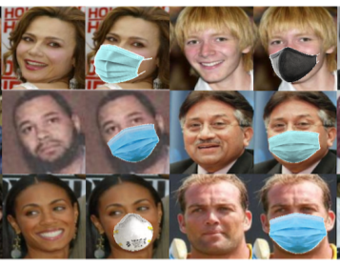
Synthetic dataset:
MaskTheFace masked-LFW
Siying
https://github.com/aqeelanwar/MaskTheFace
Notes:
3. LFW -> maskedLFW
MaskTheFace is computer vision-based script to mask faces in images. It uses a dlib based face landmarks detector to identify the face tilt and six key features of the face necessary for applying mask. Based on the face tilt, corresponding mask template is selected from the library of mask. The template mask is then transformed based on the six key features to fit perfectly on the face.

Slide 10
Training Process - Preprocessing
Kaiwen
Synthetically put on Masks on LFW with MaskTheFace
MTCNN used to crop both LFW and RMFRD
Generate specific triplet loss dataset
Notes:
Our Training Process can be divided into several stages:
In preprocessing step, we tried to generate masked face dataset .
we synthetically put on masks on Labeled Faces in wild dataset with maskTheFace tool, as mentioned before
We use MTCNN(Multi-task Cascaded Convolutional Neural Networks) to crop both LFW dataset and RMFRD(Real world masked faces recognition dataset) to get same size face images.
We generate specific triplet loss dataset, which will be used in our further training step.

Slide 11
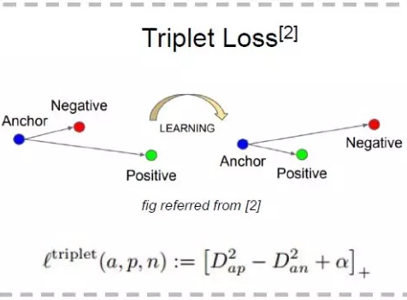
Training Process - Triplet Loss
Kaiwen
Given an image(anchor), find a positive example, a negative example
Run all three through Neural Network, calculate loss based on embeddings
Triplets dataset are generated
Notes:
Triplet loss is a loss function where an (anchor) input is compared to a positive input and a negative input. Triple loss function is used to minimize the distance between anchor and positive input while maximize the distance between anchor and the negative input.
Which is a good loss function for training facial verification tasks
In facial verification problem, a face image can be considered as an anchor input, we have to find a positive example, aka another face from the same person, and a negative example, aka a face from another person
After we have a well-defined loss function
Perform neural network on those 3 images, and calculate loss based on the embeddings, and the generate the triplets datasets

Slide 12
Training Process - Training
Kaiwen
Transfer Learning:
Take pretrained facenet, train on our own datasets
LFW and RMFRD
Notes:
Transfer learning technique is used in our model
We want to use transfer learning since we do not have enough gpu resources to train from scratch
We still want our model to be general enough to recognize unmasked pairs

Slide 13
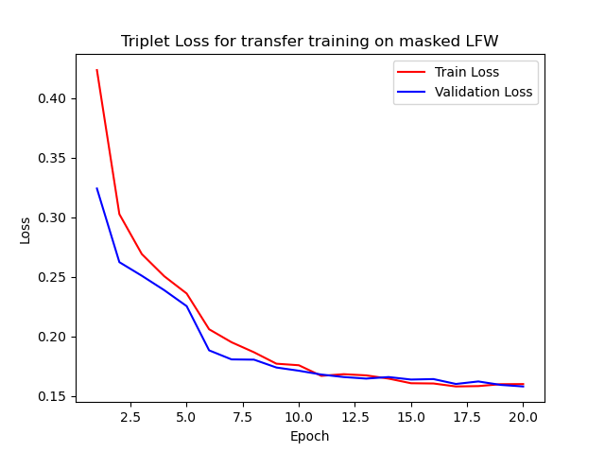
Training - Model with masked LFW
Kaiwen
Epochs: 20
Triplets generated: ~25000
Time taken: ~12 hrs
Notes:
First model is trained on Label Faces in Wild datasets
We took 25k triplets as input.

Slide 14
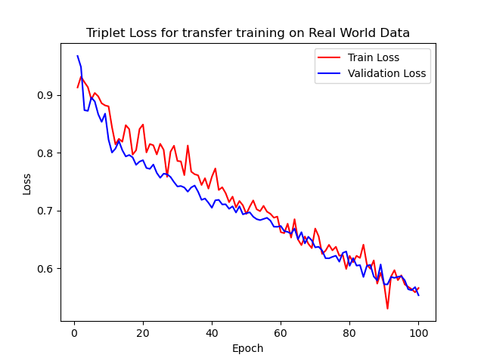
Training - Model with RWMRFD
Kaiwen
Epochs: 100
Triplets generated: ~2000
Time taken: ~2 hrs
Notes:
Real World Masked Face Recognition Dataset
It takes 2000 triplets as input
We first tried 20 epochs, which is no good, and then we tried 100 epochs
But it still did not converge, more epochs will be needed

Slide 15
Results- What we are concerned about
Hanan
Accuracy is important
True Positive rate high, False Positive rate MUST be low
False Negative rate as low as possible
Threshold Hyperparameter
Metrics:
Precision: TP / (TP + FP)
Recall: TP / (TP + FN)
Notes:
Not sure what are these 4 categories represent specifically in our proj.
What kind of model is used here?
Method? Evaluation method? - Kevin
Should be a slide on training procedure, I’ll explain in call - david

Slide 16
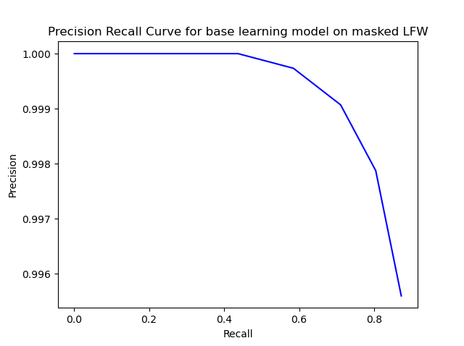
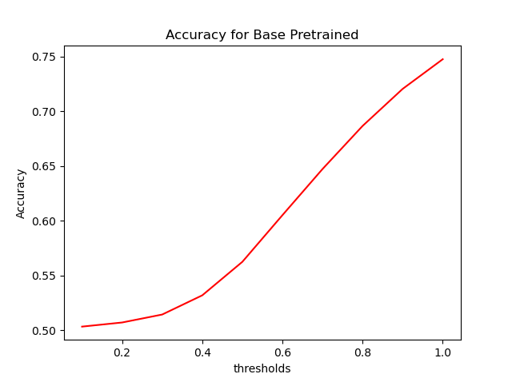
Results - Baseline
Hanan
Using Pretrained VGGFace2 on Masked LFW dataset

Slide 17
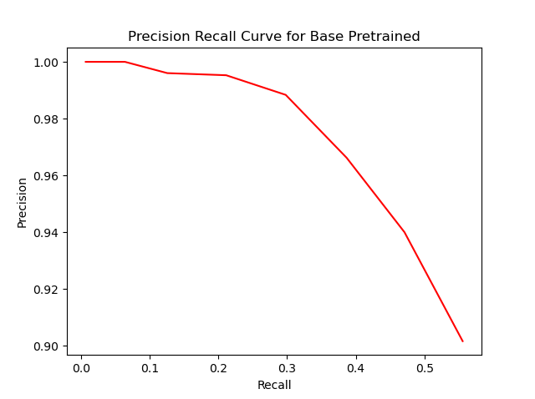
Results - Baseline
Hanan
Using Pretrained VGGFace2 on RMFRD dataset

Slide 18
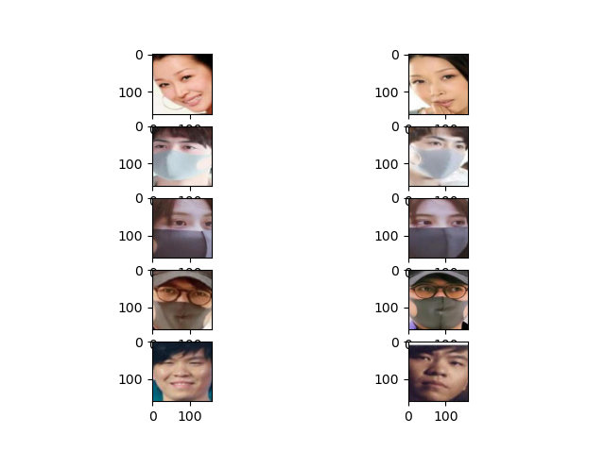
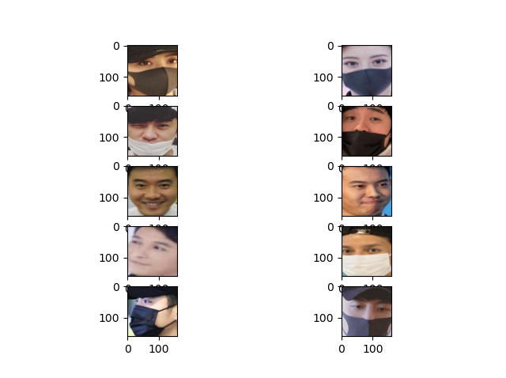
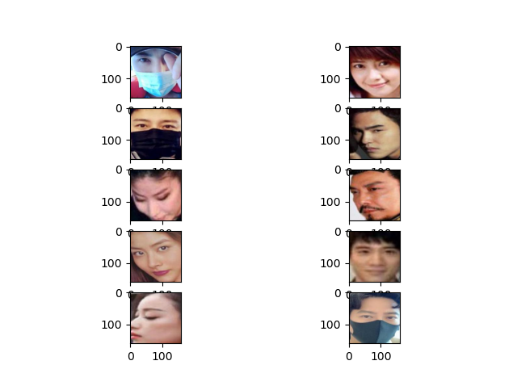
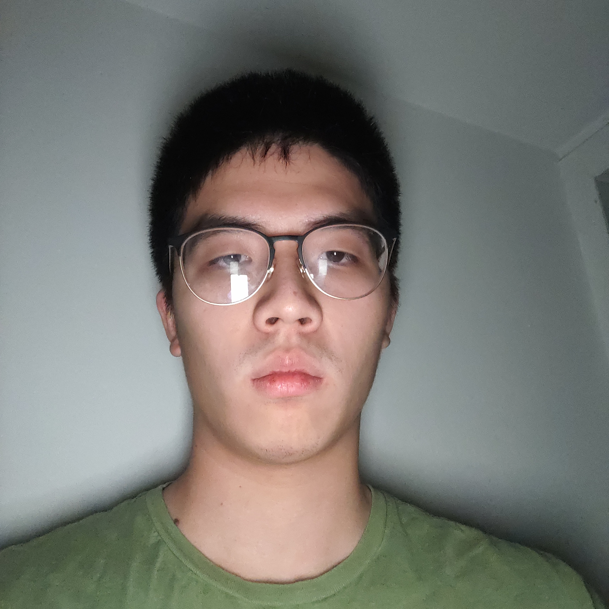
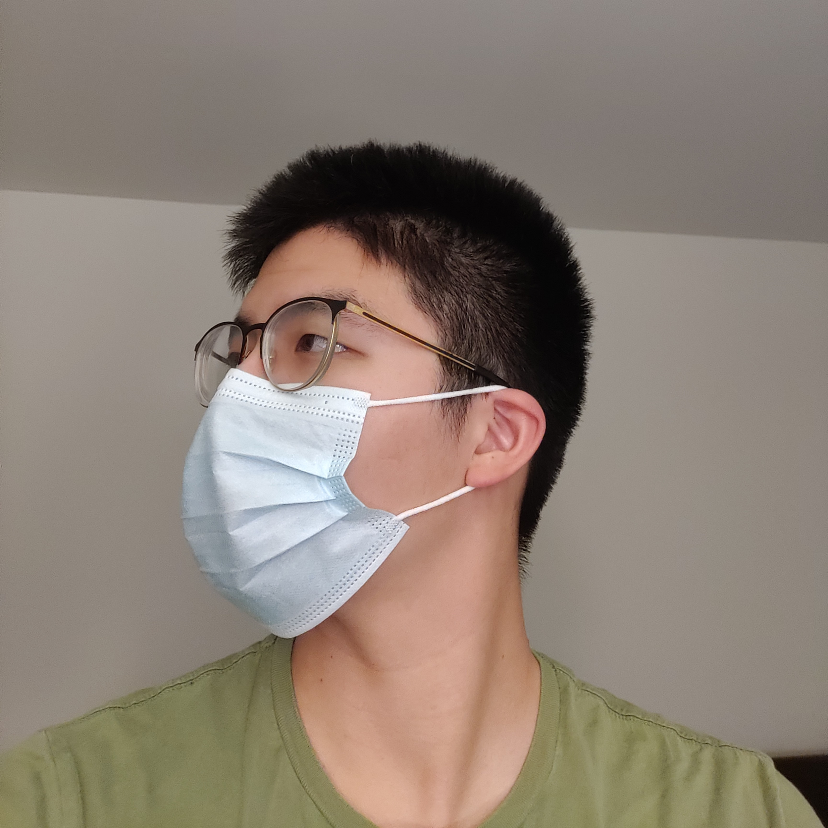
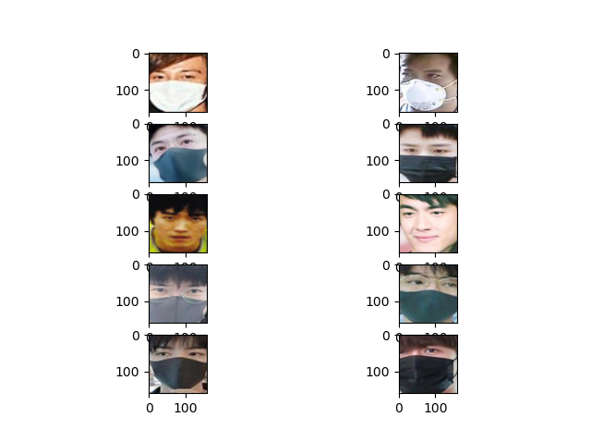
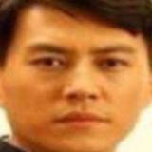
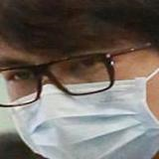
Baseline cases:
Easy Case(Correctly Classified):
Average Case(depends on threshold):
Hard Case(Incorrectly Classified):
Hanan
True Positive
Distance: 0.48
True Negative
Distance: 1.805
False Negative
Distance: 0.69
False Negative
Distance: 0.98
False Positive
Distance: 0.45
False Negative
Distance: 1.45
Notes:
pretrained

Slide 19
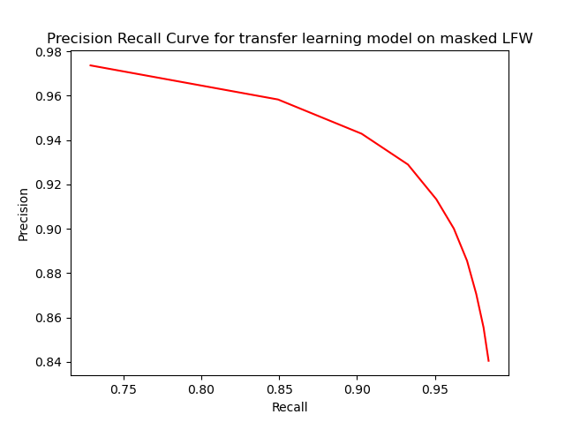
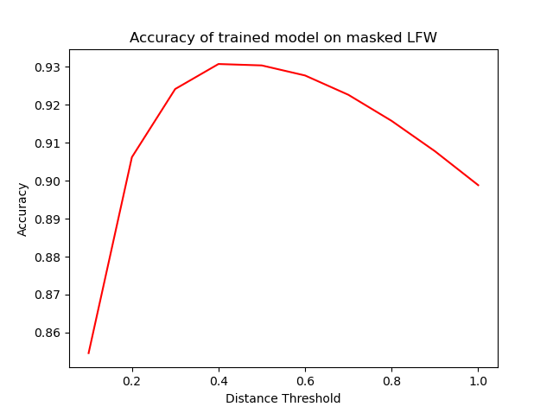
Results
Hanan
Model Trained on Masked LFW evaluated on Masked LFW
We pick a threshold of 0.4

Slide 20
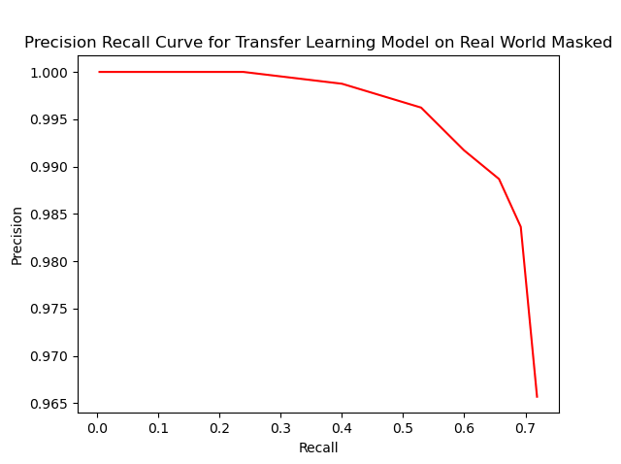
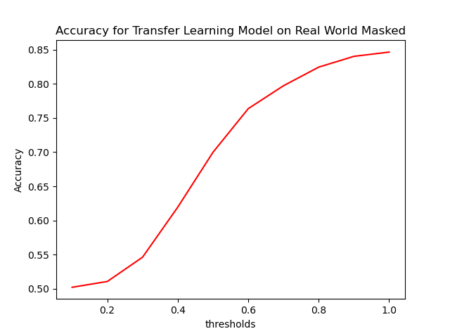
Results
Hanan
Model Trained on RMFRD evaluated on RMFRD
We pick a threshold of 1

Slide 21
Model Improvements for both models
Correctly Classified:
Average Case:
Hanan
Model trained on RMFRD: 0.12
Model trained on masked LFW: 0.31
True Positive
Positive Pair
Model trained on RMFRD: 3.44
Model trained on masked LFW: 0.60
True Negative
Model trained on RMFRD: 0.47
Model trained on masked LFW: 2.10
Model trained on RMFRD: 0.007
Model trained on masked LFW: 0.30
True Positive
Positive Pair
Model trained on RMFRD: 0.445
Model trained on masked LFW: 0.90
Model trained on RMFRD: 1.45
Model trained on masked LFW: 0.46
True Negative
Notes:
pretrained

Slide 22
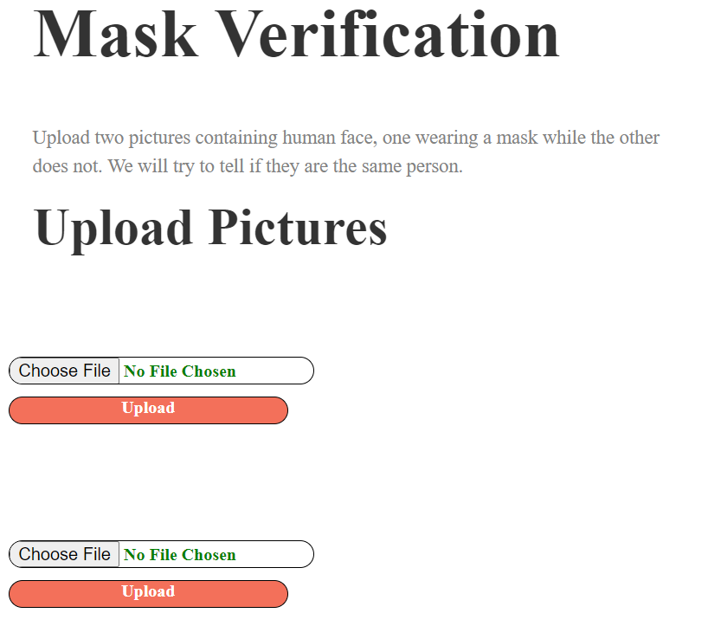
Web Design
Ziqihong Yue

Slide 23
Summary
Ziqihong Yue
· A deep learning application for face verification with masks
· Three experiments
· Wide application range

Slide 24
Future Works
Ziqihong Yue
Train with other pre-trained models
Ensemble methods using both of Neural networks trained
Actually changing neural network layers
Design models which only recognize “half faces”
Integrate Web UI with the models, will be ready for demo video

Slide 25
Thank you!
Q & A

